Slide 1
Automobile and ecology
Philminov Stepan RL6-31

Slide 2

Automobile and ecology
In recent years, there has been an increase in the incidence of respiratory organs in the world. Environmental scientists and doctors attribute this to a sharp increase in the number of vehicles.

Slide 3
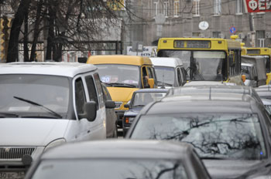
Automobile and ecology
Transport takes the first place in terms of the number of harmful emissions. 17% of global greenhouse gas emissions are released into the environment due to transport.

Slide 4
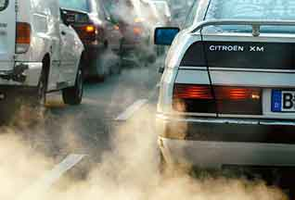
Automobile and ecology
Toxic emissions are fuel vapors. The main share of toxic impurities enters the atmosphere with the exhaust gases of the car engine. With vapors, 45% of harmful emissions enter the atmosphere.

Slide 5
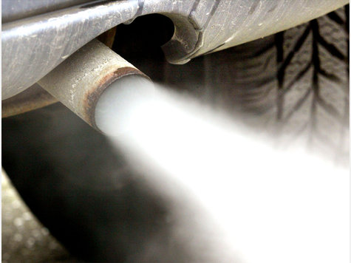
Automobile and ecology
Harmful substances are released into the atmosphere: carbon monoxide, sulfur oxides, nitrogen oxides, lead compounds, soot, hydrocarbons, benzapyrene C20H12, unburned fuel particles.

Slide 6
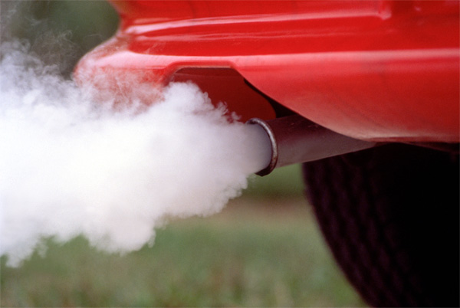
Automobile and ecology
Harmful substances enter the human body through the respiratory system. About 50% of impurity particles with a radius of 0.01-0.1 microns penetrating into the lungs are deposited in them.

Slide 7
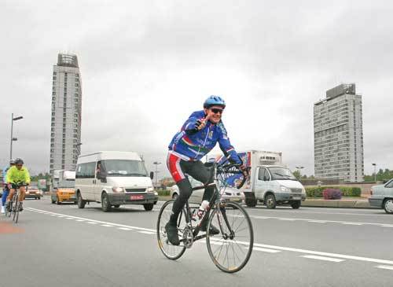
Automobile and ecology
In a number of cities around the world, measures are being taken to limit the use of individual cars for everyday driving around the city.

Slide 8
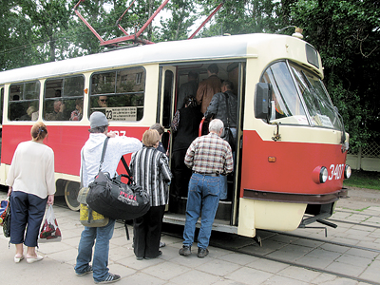
Automobile and ecology
large European cities are reducing the use of cars to travel around the city. Instead, they use the tram, trolleybus, bus, metro, bicycles and hiking.

Slide 9
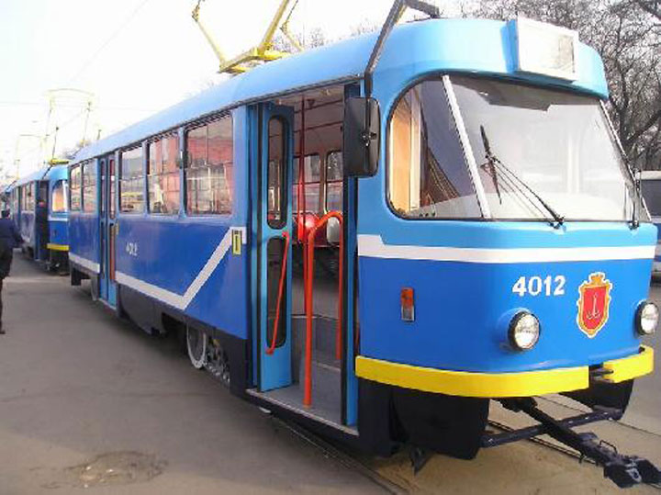
Automobile and ecology
Public transport is a cheaper and more environmentally friendly form of transport. It must be maintained.

Slide 10


